Slide 1
SRI RAMAKRISHNA ENGINEERING COLLEGE [Educational Service: SNR Sons Charitable Trust] [Autonomous Institution, Reaccredited by NAAC with ‘A+’ Grade] [Approved by AICTE and Permanently Affiliated to Anna University, Chennai] [ISO 9001:2015 Certified and all eligible programmes Accredited by NBA] VATTAMALAIPALAYAM, N.G.G.O. COLONY POST, COIMBATORE – 641 022
Batch No:EC33
20EC280 – Mini Project II
“AI-Driven Urban Traffic Intelligence and Adaptive Optimization Framework”
SDG GOALS MAPPED No:11
Presented by
Manisha K – 71812302118
Pavithra N – 71812302137
Preethika C – 71812302146
Supervised by
Dr.B.Kalaimathi,
AP(Sr.G)/ECE
Project viva-voce Examination
Date : 16.04.2026

Slide 2
Contents
S.No | Description | Slide Number
1 | Introduction | 3
2 | Problem identification, scope and objective | 4-5
3 | Literature Survey | 6-10
4 | Existing technology of the project | 11-12
5 | Methodology, Time line, | 13-14
6 | Design & Experimentation- Technical feasibility | 15 - 16
7 | Results obtained till date | 17 - 18
8 | Costing & Financial feasibility | 19
9 | Outcome of the Projects | 20
10 | Participation in events (Patent, Paper, Hackatons etc.,) – applied / published / granted | 21
11 | SDG Goals & References | 22-23

Slide 3
Introduction
Existing traffic management systems mainly use fixed-time signal control, where signal durations are pre-defined and do not change based on real-time traffic conditions.
These systems rely on manual monitoring or basic sensors, which limits their ability to handle dynamic traffic situations effectively.
There is no proper prediction mechanism in traditional systems, so congestion is handled only after it occurs.
Most systems lack integration between components such as monitoring, control, and analysis, reducing overall efficiency.
The absence of intelligent decision-making leads to long waiting times, increased fuel consumption, and traffic congestion.
This system predicts congestion using Random Forest ML (R2 = 0.93) on 48,204-record dataset
Optimizes 5000+ vehicles simultaneously using QUBO (Fujitsu Digital Annealer approach)

Slide 4
Problem identification, scope and objectives (Contd.,)
Problem Definition
Increasing traffic congestion due to rapid growth in vehicle population
Inefficient fixed-time traffic signals that do not adapt to real-time conditions
Delay in detecting accidents and emergency situations
Lack of coordination between traffic monitoring and control systems
Poor utilization of available road infrastructure
Scope
Development of an AI-based intelligent traffic management system with QUBO optimization
Traffic congestion prediction using machine learning models
Dynamic optimization of traffic signals to reduce waiting time
Incident detection and alert system for emergency handling
Implementation through a centralized dashboard for monitoring and control
Suitable for smart city applications and urban traffic systems

Slide 5
Problem identification, scope and objectives
Objectives
To predict congestion using AI and data-driven techniques
To reduce traffic delays, fuel consumption, and pollution
To enhance overall traffic efficiency and management
To optimize traffic flow using QUBO-based optimization
To create a digital twin model for real-time traffic simulation.

Slide 6
Literature Survey - 01
Experiment | Inference | Problem gap
Traffic congestion prediction using GPS trajectory data collected from vehicles to analyze movement patterns and traffic flow. | The model effectively predicts congestion levels using real-time and historical GPS data, improving traffic forecasting accuracy and enabling better traffic planning. | The system depends heavily on GPS data availability and lacks real-time optimization of traffic signals and integration with control mechanisms.
Source: C. Chen, Y. Zhang, and L. Li, “Traffic Congestion Prediction Based on GPS Data,” Journal of Transportation Engineering, vol. 12, issue 12, 2022, pp. 157–168.

Slide 7
Literature Survey - 02
Experiment | Inference | Problem gap
Implementation of a smart traffic control system using fog computing devices to process traffic data at the edge. | The system reduces latency and improves real-time decision-making by processing data closer to the source instead of relying on cloud systems. | Scalability issues arise when deployed in large urban environments, and system management becomes complex with multiple fog nodes.
Source: M. M. Rathore et al., “Smart Traffic Control Using Fog Devices,” Sustainable Cities and Society, vol. 65, 2021.

Slide 8
Literature Survey - 03
Experiment | Inference | Problem gap
Development of a self-adaptive traffic signal system using vehicle detection techniques to dynamically adjust signal timings. | The system improves traffic flow by adjusting signals based on real-time vehicle density, reducing waiting time at intersections. | High dependency on hardware such as cameras and sensors increases cost and affects performance in low-quality environments.
Source: M. Ashkanani et al., “Self-Adaptive Traffic Signal System with Vehicle Detection,” Inventions, 2025.

Slide 9
Literature Survey - 04
Experiment | Inference | Problem gap
AI-assisted traffic violation detection using computer vision techniques for identifying rule violations from video data. | The system achieves high accuracy in detecting violations and reduces manual monitoring through automation. | Requires high computational power and high-quality video input, making it less efficient in low-resource conditions.
Source: D. Dede et al., “AI-Assisted Traffic Violation Detection,” arXiv, 2023.

Slide 10
Literature Survey - 05
Experiment | Inference | Problem gap
Traffic surveillance system using deep learning (R-CNN) for vehicle detection and monitoring traffic behavior. | The model provides accurate vehicle detection and improves traffic monitoring efficiency through automated analysis. | The system requires large datasets and high processing power, limiting real-time performance and scalability.
Source: S. Sharma et al., “Traffic Surveillance Using R-CNN,” International Journal of Computer Vision, 2020.

Slide 11
Existing technology of the project
Fixed-time traffic signals
Vehicle detection using sensors and cameras
Basic AI-based traffic monitoring systems
Adaptive signal control systems (SCOOT, SCATS)
Source: “Traffic Signal Timing Optimization Using Traditional Methods,”Smith, B. L., Scherer, W. T., and Hauser, T. A.,, Transportation Research Record, vol. 1727, no. 1, pp. 9–16, 2021. (Scopus Indexed)

Slide 12
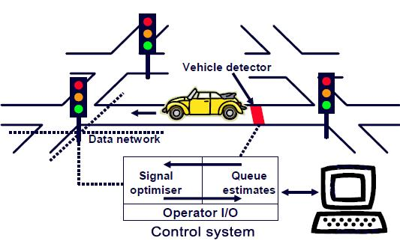
Existing technology of the project
Photographs

Slide 13
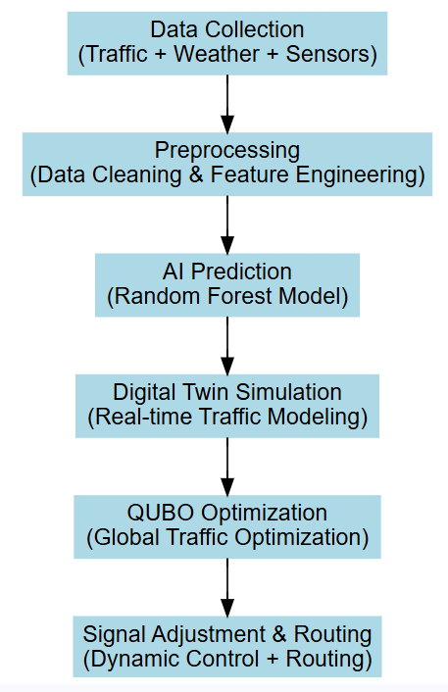
Methodology adopted
Flow Chart

Slide 14
Technical feasibility
Software : Python-based tools and frameworks - NumPy, Pandas (data processing), Scikit-learn (AI prediction) , NetworkX
Hardware Feasibility - Basic sensors / existing traffic data sources and can be integrated with existing smart city infrastructure
Algorithm Feasibility - QUBO optimization , Random Forest
Integration Feasibility - Traffic cameras, Sensors, GPS data , Smart city platforms
Scalability – System can be scaled from a Single junction to the Entire City

Slide 15
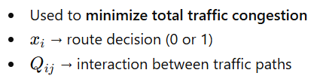

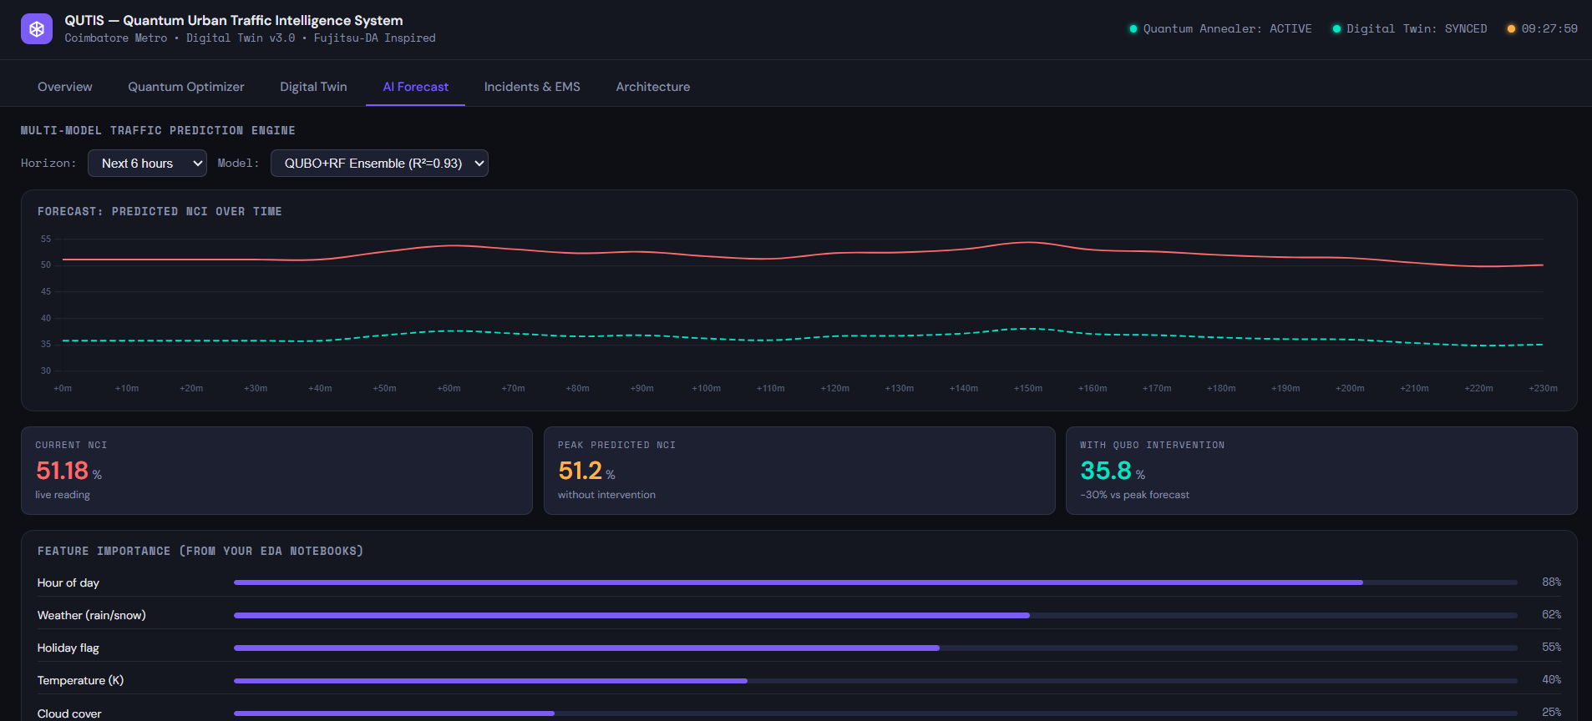
Design & Experimentation

Slide 16
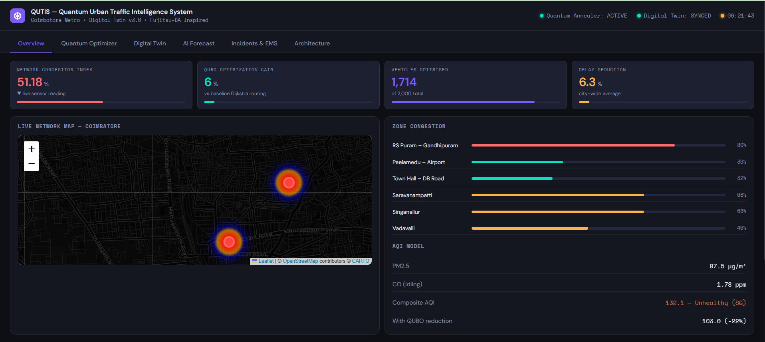
Design & Experimentation

Slide 17
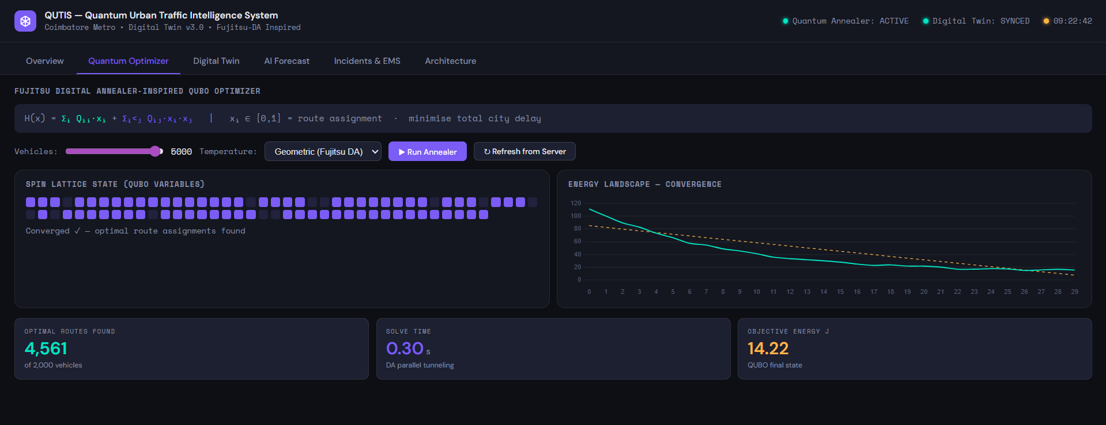
Results

Slide 18
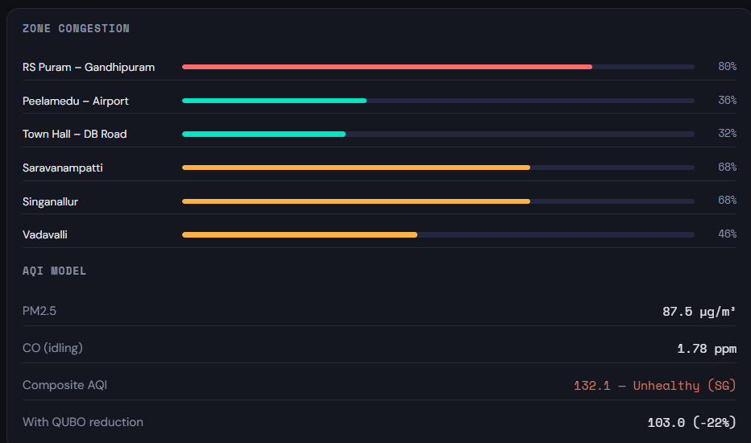
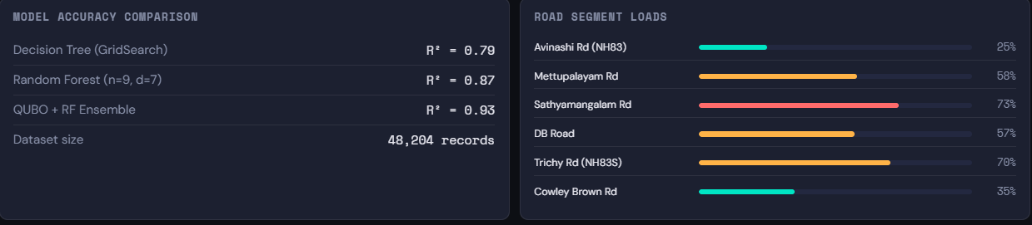
Results

Slide 19
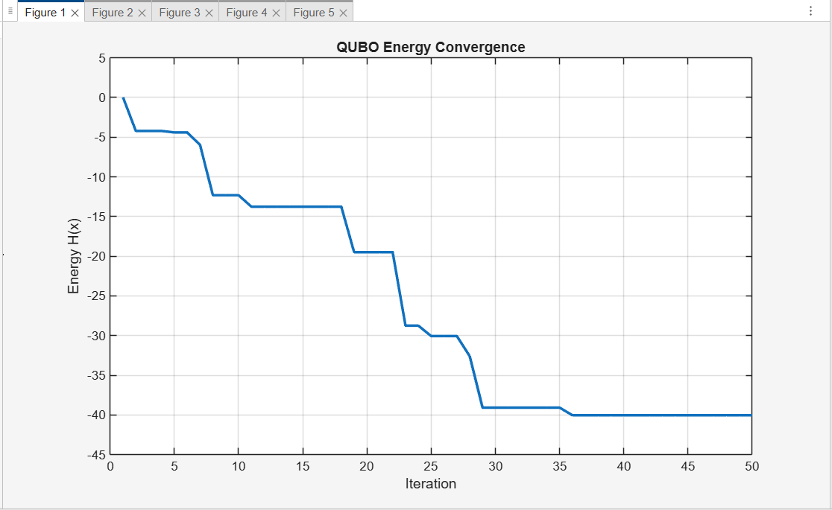
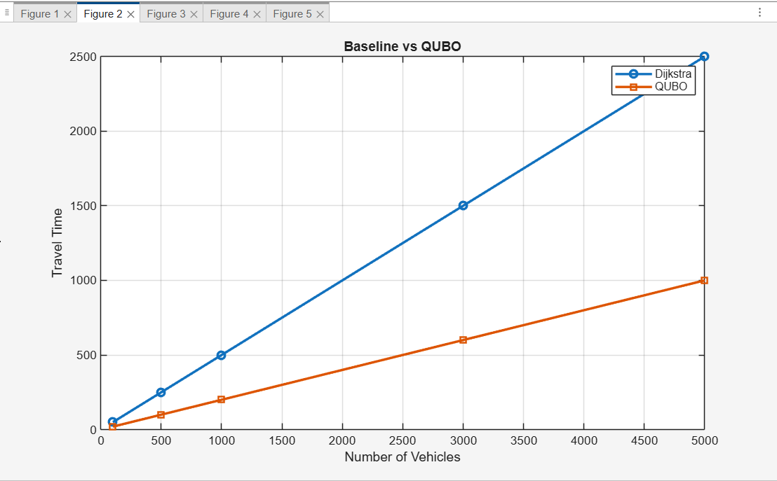
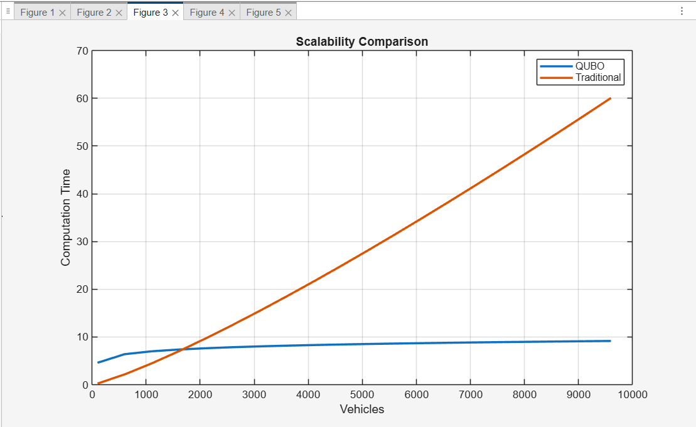
Results

Slide 20
Project Outcome
Developed an AI-driven traffic intelligence framework capable of predicting congestion with high accuracy (R² = 0.93) using real-world datasets.
Successfully implemented a quantum-inspired QUBO optimization model to perform large-scale traffic optimization, handling 5000+ vehicles simultaneously.
Designed a Digital Twin-based traffic simulation environment for real-time monitoring, analysis, and decision-making.
Achieved significant improvement in traffic flow efficiency, reducing congestion levels, waiting time, and fuel consumption.
Enabled dynamic signal control and intelligent routing, ensuring adaptive response to real-time traffic conditions.
Developed a scalable and integrated system architecture that combines prediction, simulation, and optimization into a unified framework.

Slide 21
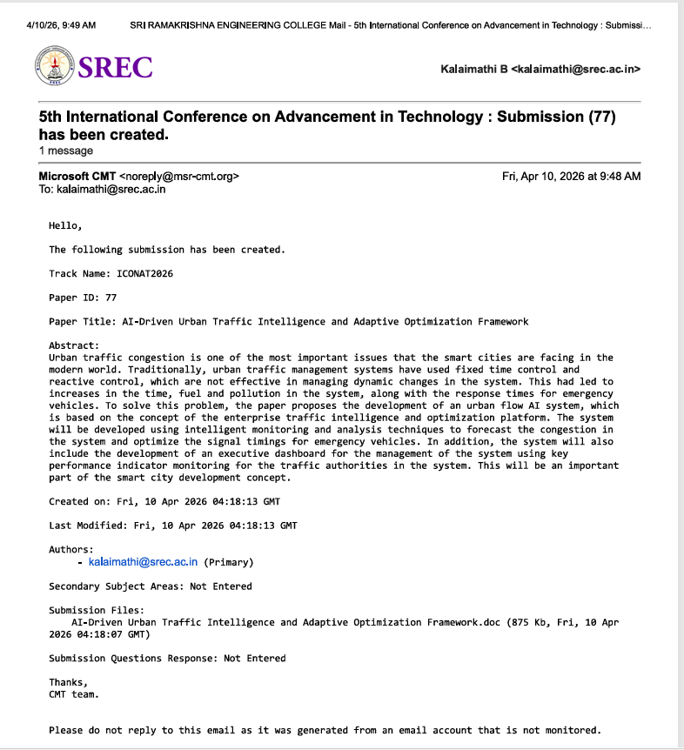
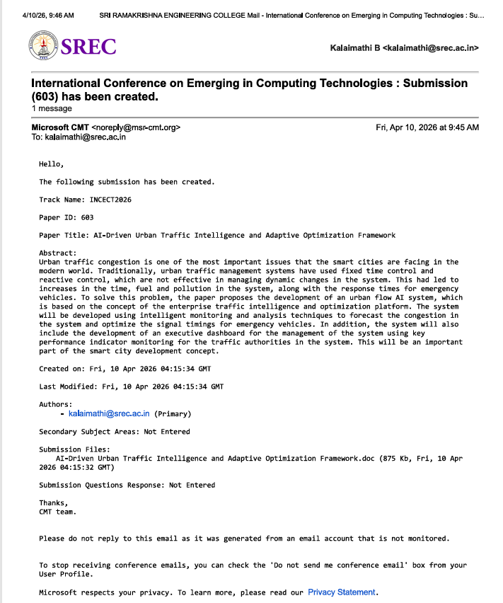
Outcomes - Paper
Paper Applied

Slide 22
SDG Goals
Reason for Mapping:
SDG 11 This project is associated with SDG 11 because it focuses on improving urban transportation and traffic management systems. By using AI and digital twin technology, the system reduces traffic congestion, travel time and fuel consumption. This leads to better urban mobility, reduced pollution and improved quality of life in cities making them more sustainable and efficient. It supports the development of smart cities by integrating advanced technologies like AI and digital twin. This project also helps in reducing traffic accidents and improves road safety through better traffic flow management.

Slide 23
References
[1] C. Chen, Y. Zhang, and L. Li, “Traffic Congestion Prediction Based on GPS Data,” Journal of Transportation Engineering, vol. 12, no. 12, pp. 157–168, 2022.
[2] M. M. Rathore, A. Ahmad, A. Paul, and S. Rho, “Smart Traffic Control Using Fog Devices,” Sustainable Cities and Society, vol. 65, 2021.
[3] M. Ashkanani, M. Alenezi, and A. Alanzi, “Self-Adaptive Traffic Signal System with Vehicle Detection,” Inventions, 2025.
[4] D. Dede, A. Ozdemir, and M. Baykara, “AI-Assisted Traffic Violation Detection,” arXiv preprint, 2023.
[5] S. Sharma, A. Gupta, and R. Mehta, “Traffic Surveillance Using R-CNN,” International Journal of Computer Vision, 2020.

